Slide 1
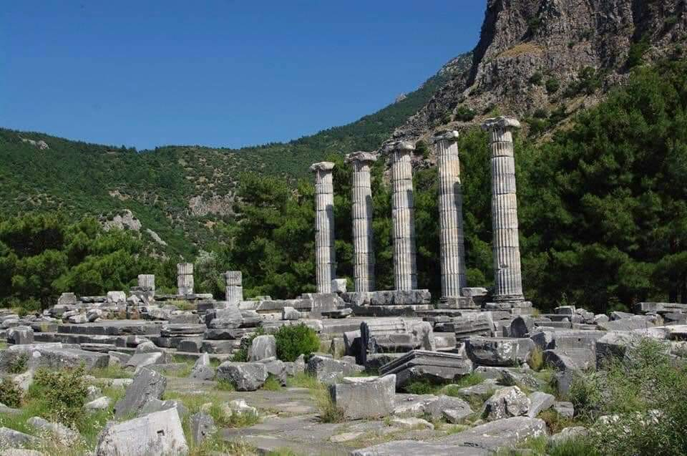
Hedgehog Rock

Slide 2

University of Science and Technology Bannu
Data Mining
Lesson 7
January 31, 2024

Slide 3
Learning Objectives
Association Rule Mining

Slide 4
Lesson outline
What is Association Rule and frequent pattern mining?
The Apriori Algorithm for Association Rule
How FP-Growth Algorithm Work in Association Rule?
Practical Implementation of the Apriori Algorithm.
Practical Implementation of FP-Growth Algorithm.

Slide 5

Frequent patterns and association rules
Imagine that you are a sales manager at AllElectronics
Primary responsibility “Sales Growth”
Customer purchased PC and Digital Camera
You are recommending new item to her/him
You can recommend a new item to her/him if you have a knowledge
Knowledge of “which products are frequently purchased by your customers following their purchases of a PC and a digital camera in sequence”
Frequent patterns and association rules are the knowledge that you want to mine in such a scenario.

Slide 6
Frequent Patterns
Frequent patterns are patterns (e.g., itemsets, subsequences) that appear frequently in a data set.
For example, a set of items, such as milk and bread, that appear frequently together in a transaction data set is a frequent itemset.
A subsequence, such as buying first a PC, then a digital camera, and then a memory card, if it occurs frequently in a shopping history database, is a (frequent) sequential pattern.
Frequent patterns searches for recurring relationships in a given data set.

Slide 7
Frequent Patterns
Frequent patterns
Itemset
For example, a set of items, such as milk and bread, that appear frequently together in a transaction data set is a frequent itemset.
subsequences
A subsequence, such as buying first a PC, then a digital camera, and then a memory card, if it occurs frequently in a shopping history database, is a (frequent) sequential pattern.

Slide 8
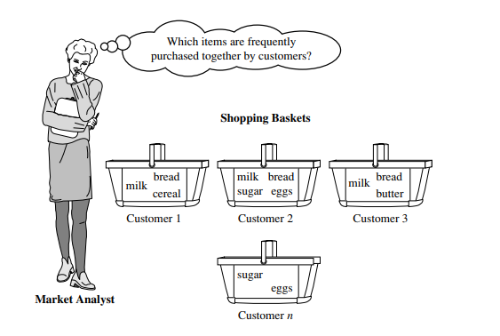
Market Basket Analysis: A Motivating Example
A typical example of frequent itemset mining is market basket analysis
A Market basket is a collection of items purchased by a customer in a single transaction, which is a well-defined business activity.

Slide 9
Market Basket Analysis: A Motivating Example
Market Basket Analysis analyzes customer buying habits by finding associations between the different items that customers place in their “shopping baskets”
The discovery of these associations can help retailers develop marketing strategies by gaining insight into which items are frequently purchased together by customers.
For instance, if customers are buying milk, how likely are they to also buy bread (and what kind of bread) on the same trip to the supermarket?
This information can lead to increased sales by helping retailers do selective marketing and plan their shelf space.

Slide 10

Example
“Which groups or sets of items are customers likely to purchase on a given trip to the store?”
Question

Slide 11

Example
To answer your question, market basket analysis may be performed on the retail data of customer transactions at your store.
You can then use the results to plan marketing or advertising strategies, or in the design of a new catalog.

Slide 12
Example
For instance, market basket analysis may help you design different store layouts.
In one strategy, items that are frequently purchased together can be placed in proximity to further encourage the combined sale of such items.
If customers who purchase computers also tend to buy antivirus software at the same time, then placing the hardware display close to the software display may help increase the sales of both items.

Slide 13
Association rule
These patterns can be represented in the form of association rules.
For example, the information that customers who purchase computers also tend to buy antivirus software at the same time is represented in the following association rule:
support and confidence are two measures of rule interestingness.
They respectively reflect the usefulness and certainty of discovered rules

Slide 14
Association rule
Rule means that 2% of all the transactions under analysis show that computer and antivirus software are purchased together.
A confidence of 60% means that 60% of the customers who purchased a computer also bought the software

Slide 15
Association rule
Support refers to the frequency or occurrence of a particular itemset in the dataset. It shows how frequently an itemset appears in the entire dataset.
Confidence measures the reliability or strength of the association between two items A and B in a rule.
It indicates the likelihood that item B will be purchased when item A is purchased.

Slide 16
Association rule
Support Calculation: Support for an itemset (e.g., {Diaper, Beer}) is calculated by dividing the number of transactions containing both Diaper and Beer by the total number of transactions.
Suppose there were 1000 transactions, and in 5 of those, both Diapers and Beer were purchased:
Support = (Transactions containing Diaper and Beer) / (Total transactions) = 5 / 1000 = 0.5%

Slide 17
Association rule
Confidence Calculation: Confidence measures how often Beer is purchased when Diapers are purchased.
Confidence = (Transactions containing both Diaper and Beer) / (Transactions containing Diaper)
Confidence = 5 / (Number of transactions containing Diaper)
If 75% of transactions containing Diapers also contain Beer, the confidence is 75%.

